Slide 1

Moving Average Time Series
Dr. Abolfazl Saghafi
Assistant Professor of Statistics & Data Science
Notes:
This week we introduce Moving Average time series and investigate their properties

Slide 2
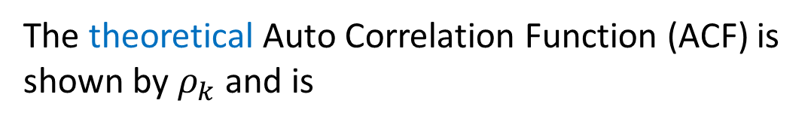


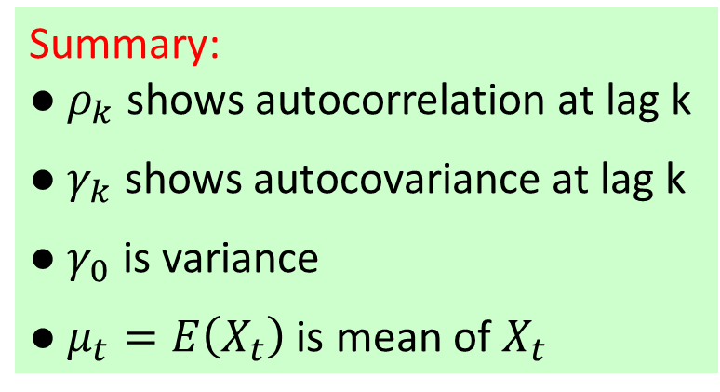



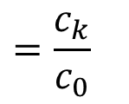

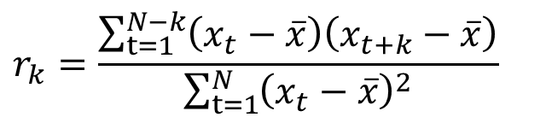
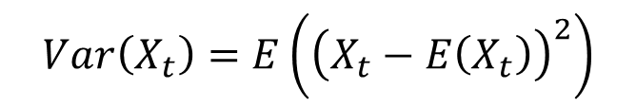
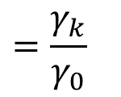
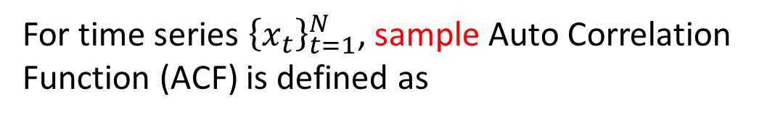
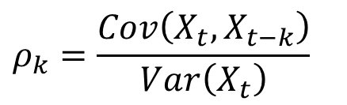
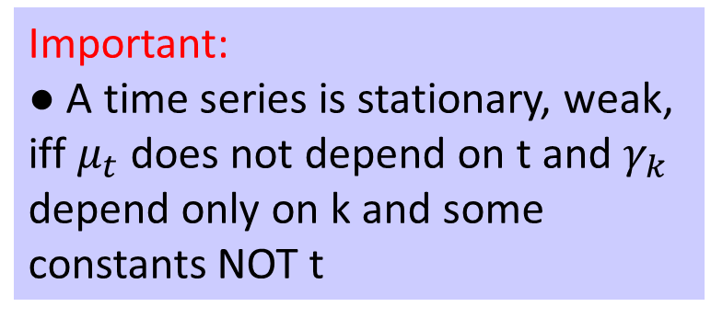
Sample Vs Theoretical
Summary:
● $ρ_{k}$ shows autocorrelation at lag k
● $γ_{k}$ shows autocovariance at lag k
● $γ_{0}$ is variance
● $μ_{t}=E\left(X_{t}\right)$is mean of $X_{t}$
For time series ${\left\{x_{t}\right\}}_{t=1}^{N}$, sample Auto Correlation Function (ACF) is defined as
$$r_{k}=\frac{\sum_{t=1}^{N−k}{\left(x_{t}−\overline{x}\right)\left(x_{t+k}−\overline{x}\right)}}{\sum_{t=1}^{N}{{\left(x_{t}−\overline{x}\right)}^{2}}}$$
$$=\frac{c_{k}}{c_{0}}$$
$$k=0,1,2,…$$
Important:
● A time series is stationary, weak, iff $μ_{t}$ does not depend on t and $γ_{k}$ depend only on k and some constants NOT t
The theoretical Auto Correlation Function (ACF) is shown by $ρ_{k}$ and is
$$ρ_{k}=\frac{Cov\left(X_{t},X_{t−k}\right)}{Var\left(X_{t}\right)}$$
$$=\frac{γ_{k}}{γ_{0}}$$
$$k=0,1,2,…$$
where
$$γ_{0}=$$
$$Var\left(X_{t}\right)=E\left({\left(X_{t}−E\left(X_{t}\right)\right)}^{2}\right)$$
$$=E\left({X_{t}}^{2}\right)−{\left(E\left(X_{t}\right)\right)}^{2}$$
$$γ_{k}=$$
$$Cov\left(X_{t},X_{t−k}\right)=E\left(\left(X_{t}−E\left(X_{t}\right)\right)\left(X_{t−k}−E\left(X_{t−k}\right)\right)\right)$$
$$=E\left(X_{t}X_{t−k}\right)−E\left(X_{t}\right)E\left(X_{t−k}\right)$$
Notes:
We learned how to compute auto-correlations for a given time series last week. It is shown by $r_{k}$ for values of k=0,1,2,.. and is equal to sample covariance over sample variance. We also use these common notations, $c_{k}$ for sample covariance and $c_{0}$ for sample variance.
This value that can be computed for a data, represents a sample estimation of a parameter, of a theoretical statistic which is shown by $ρ_{k}$ and is computed by dividing the theoretical covariance computed at lag k, over variance of random variable $X_{t}$. We follow a notation here which is common among time series literature. Greek letter $γ_{0}$ represents variance, which you know from probability is …, $γ_{k}$ is used to show covariance of $X_{t}$ and its lag k variable $X_{t−k}$.

Slide 3
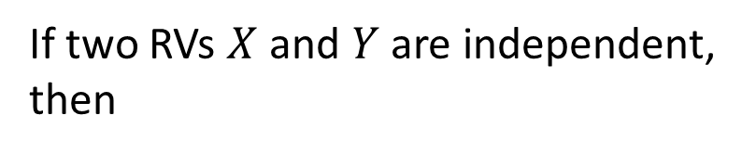
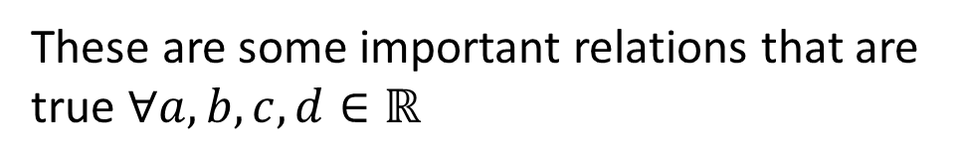

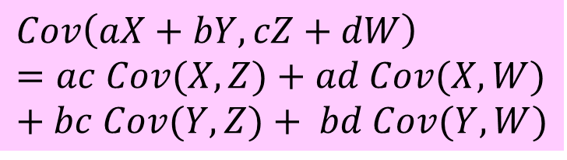


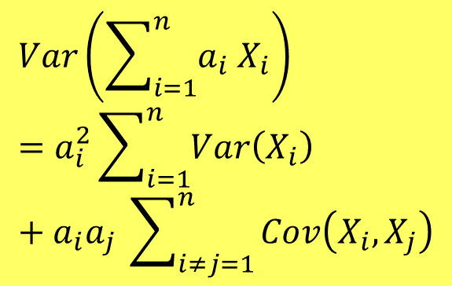



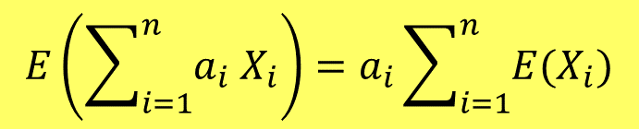
Important Relations
If two RVs $X$ and $Y$ are independent, then
$$E\left(XY\right)=E\left(X\right)E\left(Y\right)$$
These are some important relations that are true $∀a,b,c,d∈ℝ$
$$Cov\left(X,Y\right)=0=Corr\left(X,Y\right)$$
$$E\left(aX+b\right)=aE\left(X\right)+b$$
$$E\left(\sum_{i=1}^{n}{a_{i} X_{i}}\right)=a_{i}\sum_{i=1}^{n}{{E(X}_{i})}$$
$$E\left(aX+bY\right)=a E\left(X\right)+b E\left(Y\right)$$
$$Var\left(aX+b\right)=a^{2}Var\left(X\right)$$
$$Var\left(aX+bY\right)=a^{2}Var\left(X\right)+b^{2}Var\left(Y\right)+ab Cov\left(X,Y\right)$$
$$Var\left(\sum_{i=1}^{n}{a_{i} X_{i}}\right)=a_{i}^{2}\sum_{i=1}^{n}{Var\left(X_{i}\right)}+a_{i}a_{j} \sum_{i≠j=1}^{n}{Cov\left(X_{i},X_{j}\right)}$$
$$Cov\left(aX+b,cY+d\right)=ac Cov\left(X,Y\right)$$
$$Cov\left(X,Y\right)=Cov\left(Y,X\right)$$
$$Cov\left(X,X\right)=Var\left(X\right)$$
$$Cov\left(aX+bY,cZ+dW\right)=ac Cov(X,Z)+ad Cov(X,W)+bc Cov(Y,Z)+ bd Cov(Y,W)$$
Notes:
These are some important relations regarding expected value, variance, and covariance from probability theory. Since we are going to model time series using probabilistic rules, it’s best to recall them. We assume that a, b, c, and d are constant real values.
The two gold relations and the pink one are the ones that we will be using A LOT.

Slide 4
Example
E(X) = 5 Var(X) = 4
E(Y) = 10 Var(Y) = 9
Two independent random variables X and Y are given each with expected values equal to 5 and 10, and variances equal to 4 and 9. a) What is the expected value and variance of random variables:
V = 2X - Y W = X + 3Y
b) What happens if covariance of X and Y is equal to -4? what is covariance of V and W?
E(V) = E(2X-Y) =
2E(X) – E(Y) = 2*5 – 10 = 0
b) No Change
E(W) = E(X+3Y) =
E(X) + 3E(Y) = 5 + 3*10 = 35
Var(V) = Var(2X-Y) =
2² Var(X) + (-1)² Var(Y)
= 4*4 + 9 = 25
Var(W) = Var(X+3Y) =
Var(X) + 3² Var(Y)
= 4 + 9*9 = 85
b)
Var(V) = Var(2X-Y) =
2² Var(X) + (-1)² Var(Y) + (-1)(2) Cov(X,Y)
= 25 + (-2)(-4) = 33
Var(W) = Var(X+3Y) =
Var(X) + 3² Var(Y) + (1)(3) Cov(X,Y)
= 85 + (3)(-4) = 72
Notes:
Lets practice those formulas with this example.
To see the answer for covariance, check out the transcript section of the slides.
Cov(V,W) = Cov(2X-Y, X+3Y) = 2 Cov(X,X) +6 Cov(X,Y) - Cov(Y,X) -3 Cov(Y,Y)
= 2 Var(X) +6 Cov(X,Y) – Cov(X,Y) -3 Var(Y)
= (2*4) + (5*-4) + (-3*9) = -39

Slide 5

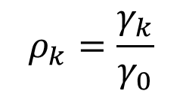








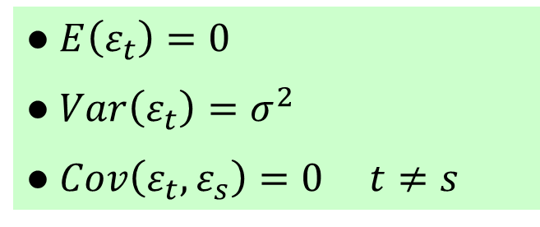






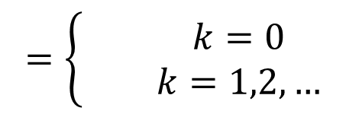
White Noise
● $E\left(ε_{t}\right)=0$
● $Var\left(ε_{t}\right)=σ^{2}$
● $Cov\left(ε_{t},ε_{s}\right)=0$ $t≠s$
Compute the ACF function for a white noise.
$$X_{t}=ε_{t}$$
$$ε_{t} \sim ^{i.i.d} N\left(0, σ\right)$$
$$\hat{σ}=RMSE$$
$$μ_{t}=E\left(ε_{t}\right)=0$$
$$γ_{0}=Var\left(X_{t}\right)$$
$$=Var\left(ε_{t}\right)$$
$$=σ^{2}$$
$$ρ_{k}$$
$$γ_{k}=Cov\left(X_{t},X_{t−k}\right)$$
$$k=1,2,…$$
1
$$=Cov\left(ε_{t},ε_{t−k}\right)$$
$$=0$$
$$=\left\{\begin{matrix} & k=0 \\ & k=1,2,…\end{matrix}\right.$$
$$ρ_{k}=\frac{γ_{k}}{γ_{0}}$$
$$1$$
0
1
2
3
4
5
6
$$k$$
$$0$$
-1
Notes:
Talking about white noise again, lets theoretically compute its ACF. Assume $X_{t}$ is a white noise with mean zero and standard deviation sigma. This means that …
So, the ACF will be like this, a big spike representing $ρ_{0}$, the rest of $ρ_{k}$ is equal to zero. This is the theoretical autocorrelogram, you don’t really see something like this in time series data BUT you will see small values for $r_{k}$ that are very close to zero

Slide 6
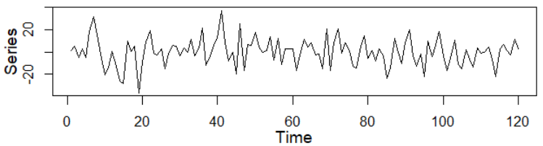
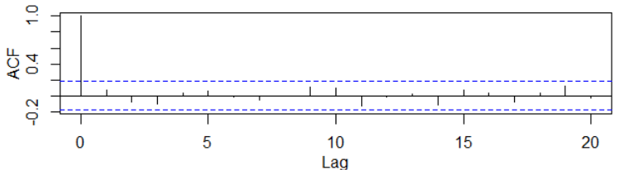
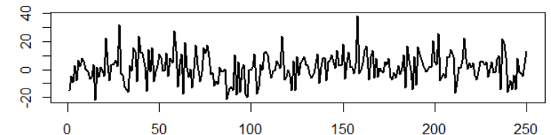
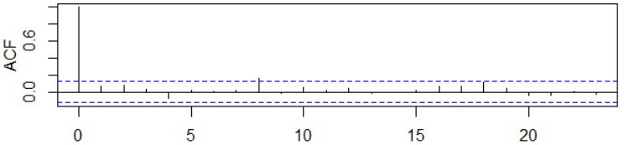


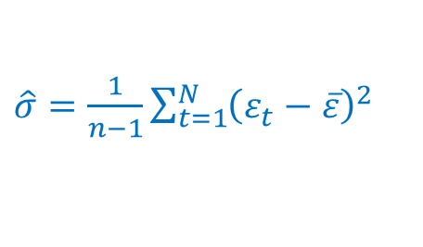
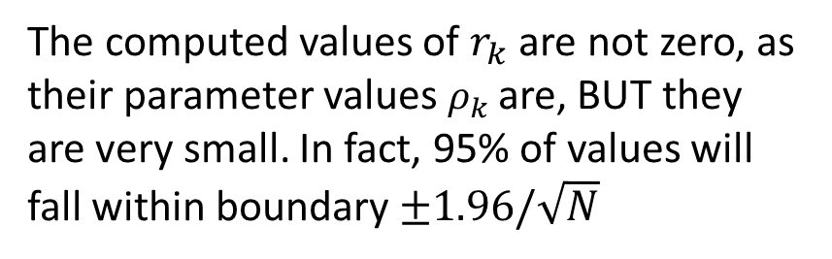


Example
Examples of white noise time series with their auto-correlogram.
$$X_{t}=ε_{t}$$
$$ε_{t} \sim ^{i.i.d} N\left(0, 12\right)$$
$$X_{t}=ε_{t}$$
$$ε_{t} \sim ^{i.i.d} N\left(0, 10\right)$$
The computed values of $r_{k}$ are not zero, as their parameter values $ρ_{k}$are, BUT they are very small. In fact, 95% of values will fall within boundary $±1.96/\sqrt{N}$
$\hat{σ}=\frac{1}{n−1}\sum_{t=1}^{N}{{\left(ε_{t}−\overline{ε}\right)}^{2}}$
Notes:
Here we see examples of white noise time series and their autocorrelogram. The first series on top, has a mean of zero and standard deviation 12. You can see random fluctuations around zero in the time plot. In the ACF, you see that $r_{0}$ is 1, and values of $r_{k}$ are very small, the plot is graphed for k up to 20. They fall within that boundary which is about ±0.18, which is a 95% confidence interval for standard normal variates, that is ±1.96/√120.
In the second plot, we have a white noise with standard deviation 10. Looking at the ACF plot, you can see that …
One important point here that we also mentioned in the R sessions is that, the standard deviation of white noise can be estimated using sample standard deviation of the time series, that is RMSE in regression results.

Slide 7




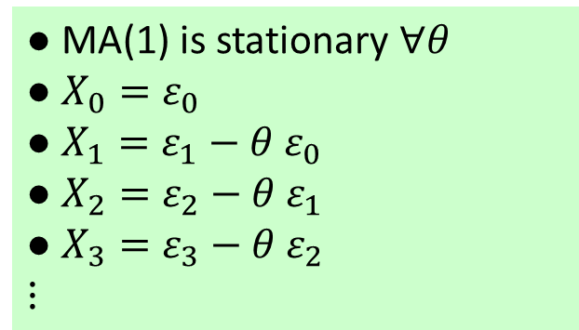
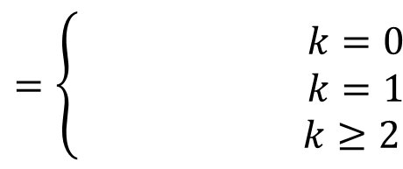


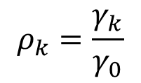







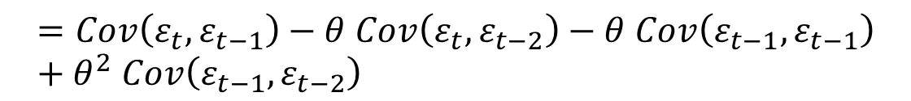








Moving Average of Oder 1
● MA(1) is stationary $∀θ$
● $X_{0}=ε_{0}$
● $X_{1}=ε_{1}−θ ε_{0}$
● $X_{2}=ε_{2}−θ ε_{1}$
● $X_{3}=ε_{3}−θ ε_{2}$
$$⋮$$
The following time series is a MA(1). Compute the ACF function and discuss stationarity.
$$X_{t}=ε_{t}−θ ε_{t−1}$$
$$ε_{t} \sim ^{i.i.d} N\left(0, σ\right)$$
$$μ_{t}=E\left(X_{t}\right)$$
$$=E\left(ε_{t}−θ ε_{t−1}\right)$$
$$=E\left(ε_{t}\right)−θ E\left(ε_{t−1}\right)$$
$$=0$$
$θ∈\left[−1,1\right]$ $⇒$ $ρ_{1}∈\left[−0.5,0.5\right]$
$$γ_{0}=Var\left(X_{t}\right)$$
$$=Var\left(ε_{t}−θ ε_{t−1}\right)$$
$$=Var\left(ε_{t}\right)+θ^{2} Var\left(ε_{t−1}\right)$$
$$=\left(1+θ^{2}\right) σ^{2}$$
$$γ_{1}=Cov\left(X_{t},X_{t−1}\right)$$
$$=Cov\left(ε_{t}−θ ε_{t−1},ε_{t−1}−θ ε_{t−2}\right)$$
$$ρ_{k}$$
$$=Cov\left(ε_{t},ε_{t−1}\right)−θ Cov\left(ε_{t},ε_{t−2}\right)−θ Cov\left(ε_{t−1},ε_{t−1}\right)+θ^{2} Cov\left(ε_{t−1},ε_{t−2}\right)$$
$$θ=0.5$$
1
$$=−θ σ^{2}$$
$$γ_{k}=0$$
$$k=2,…$$
1
$$=\left\{\begin{matrix} & k=0 \\ & k=1 \\ & k≥2\end{matrix}\right.$$
$$k$$
$$1$$
0
2
3
4
5
6
$$ρ_{k}=\frac{γ_{k}}{γ_{0}}$$
$$−θ/\left(1+θ^{2}\right)$$
$$0$$
-1
Notes:
Lets move to defining moving average time series and investigating their properties. The following time series is a moving average of order 1. We want to compute the ACF function and see how it looks like, so that to identify MA(1) when we come across some data that resembles this pattern. Values of time series consist of a random noise, subtracted by a coefficient shown by θ times a random noise from a previous time step. It is important to not that this time series is stationary for all value of θ.
Variance is constant and does not depend on time.
Looking at the value of $ρ_{1}$, the denominator is greater than the numerator, if $θ$ is a number in closed interval $\left[−1,1\right]$, $ρ_{1}$ will be between $\left[−0.5,0.5\right]$. These are the maximum value that $ρ_{1}$ can achieve.
Here is an example ACF plotted for $θ=0.5$. The spike at $ρ_{1}$ is negative and smaller than 0.5, other values of $ρ_{k}$ are all zero for $k≥2$.

Slide 8
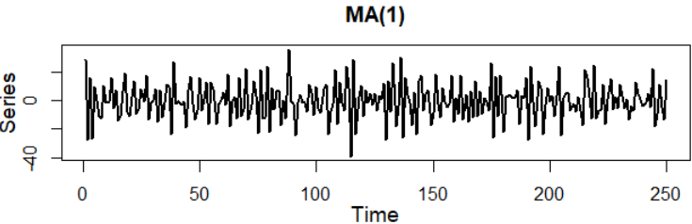
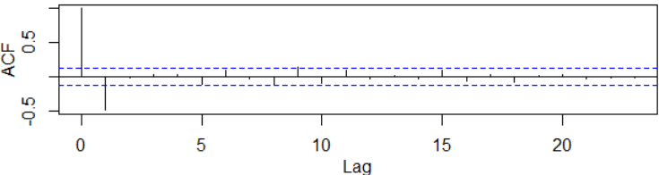
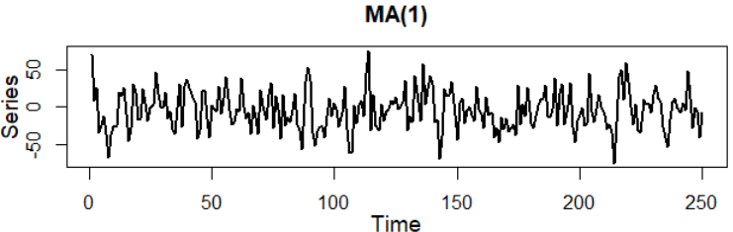
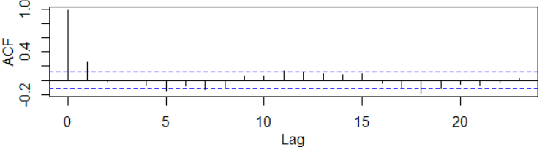




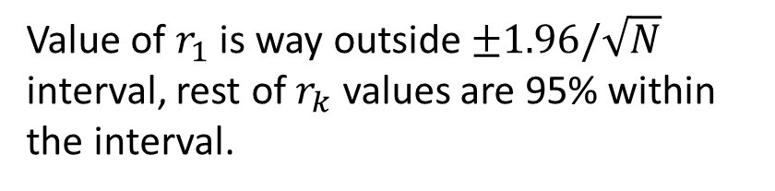


Example
Examples of MA(1) time series with their auto-correlogram.
$$X_{t}=ε_{t}−0.8 ε_{t−1}$$
$$ε_{t} \sim ^{i.i.d} N\left(0, 10\right)$$
$$X_{t}=ε_{t}+0.3 ε_{t−1}$$
$$ε_{t} \sim ^{i.i.d} N\left(0, 25\right)$$
Value of $r_{1}$ is way outside $±1.96/\sqrt{N}$ interval, rest of $r_{k}$ values are 95% within the interval.
Estimate $θ$ using
$$−θ/\left(1+θ^{2}\right)= r_{1}$$
Notes:
We see examples of MA(1) here, looking at the time plot, you can’t really tell the difference between this time series and white noise. ACF plot help us in identifying an moving average of order 1 here since there is big spike for $r_{1}$, and all $r_{k}$ values for $k≥2$ are within a 95% confidence interval for white noise. We can also estimate the parameter of this moving average $θ$ by setting the theoretical value of $ρ_{1}$ that is $−θ/\left(1+θ^{2}\right)$ equal to $r_{1}$ that is the sample value. We will discuss parameter estimations in future sessions with mor details.
In the second example, I am using a smaller value for the parameter, -0.3, for the simulation. I have increased standard deviation to 25. Similar pattern is observed in ACF plot. Since the parameter was negative, my spike at $r_{1}$ is positive. There are two spikes for lags 5 and 17 that fall a bit outside the interval, but their value is VERY close to the boundary AND a 5% inconsistency is expected, that is roughly 1 or two in 25 lags.

Slide 9
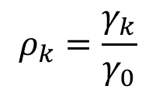


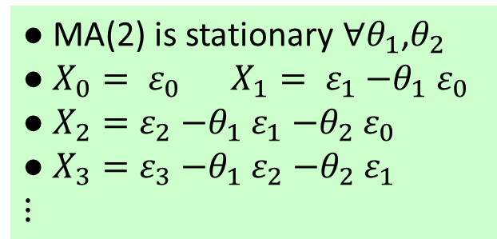



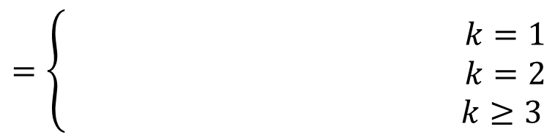











Moving Average of Oder 2
● MA(2) is stationary $∀θ_{1}$,$θ_{2}$
● $X_{0}= ε_{0}$ $X_{1}= ε_{1}{−θ}_{1}ε_{0}$
● $X_{2}=ε_{2}{−θ}_{1}ε_{1}{−θ}_{2}ε_{0}$
● $X_{3}=ε_{3}{−θ}_{1}ε_{2}{−θ}_{2}ε_{1}$
$$⋮$$
The following time series is a MA(2). Compute the ACF function and discuss stationarity.
$$X_{t}=ε_{t}{−θ}_{1}ε_{t−1}{−θ}_{2}ε_{t−2}$$
$$ε_{t} \sim ^{i.i.d} N\left(0, σ\right)$$
$ρ_{k}$is zero for $k≥3$
$$μ_{t}=E\left(X_{t}\right)$$
$$=E\left(ε_{t}{−θ}_{1}ε_{t−1}{−θ}_{2}ε_{t−2}\right)$$
$$=0$$
$$γ_{0}=Var\left(X_{t}\right)$$
$$=Var\left(ε_{t}{−θ}_{1}ε_{t−1}{−θ}_{2}ε_{t−2}\right)$$
$$=\left(1+θ_{1}^{2}+θ_{2}^{2}\right) σ^{2}$$
$$γ_{1}=Cov\left(X_{t},X_{t−1}\right)$$
$$=\left({−θ}_{1}+θ_{1}θ_{2}\right)σ^{2}$$
$$ρ_{k}$$
$$γ_{2}=Cov\left(X_{t},X_{t−2}\right)$$
$$=−θ_{2}σ^{2}$$
$$θ_{1}=0.8,θ_{2}=0.5$$
1
$$γ_{k}=0$$
$$k=3,…$$
$$=\left\{\begin{matrix} & k=1 \\ & k=2 \\ & k≥3\end{matrix}\right.$$
1
2
$$({−θ}_{1}+θ_{1}θ_{2})/\left(1+θ_{1}^{2}+θ_{2}^{2}\right)$$
$$ρ_{k}=\frac{γ_{k}}{γ_{0}}$$
0
3
4
5
6
$$k$$
$${−θ}_{1}/\left(1+θ_{1}^{2}+θ_{2}^{2}\right)$$
$$0$$
-1
Notes:
Continuing with Moving Average of order 2, this time series is defined as shown here, values are composed of a random noise, minus a parameter shown by $θ_{1}$ times a noise from previous time step, minus another parameter shown by $θ_{2}$ times a noise from two time steps from the past. A moving average of order 2 is stationary for any values of the two parameters. In order to simulate this time series, we need two initial sentences, …
As an example, plot of ACF looks like this given the two parameters as 0.8 and 0.5. Other forms of pattern is possible, like the first two spikes upward, or one upward and one downward, one bigger than the other. What’s important here is that values of $ρ_{k}$are zero for $k≥3$

Slide 10
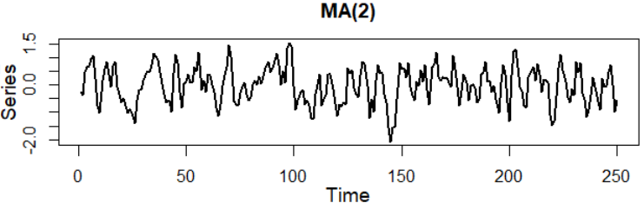
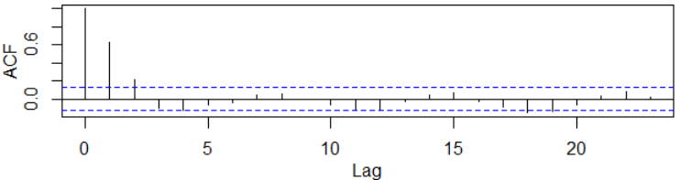
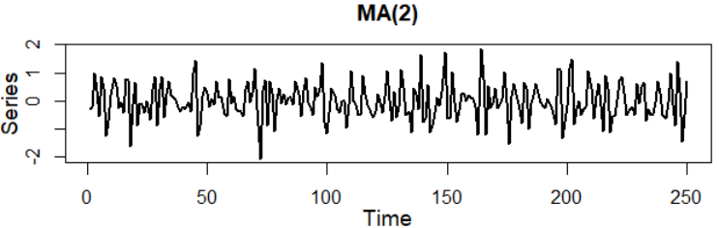
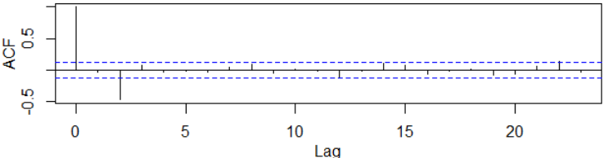

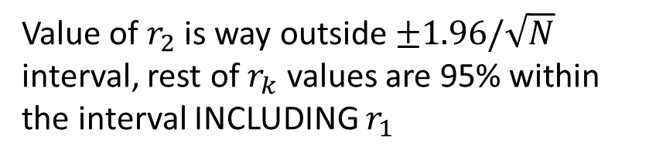



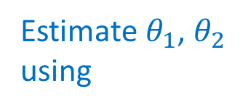

Example
Examples of MA(2) time series with
$$ε_{t} \sim ^{i.i.d} N\left(0, 0.5\right)$$
$$X_{t}=ε_{t}+0.3ε_{t−1}−0.8ε_{t−2}$$
$$X_{t}=ε_{t}+0.9ε_{t−1}+0.75ε_{t−2}$$
Value of $r_{2}$ is way outside $±1.96/\sqrt{N}$ interval, rest of $r_{k}$ values are 95% within the interval INCLUDING $r_{1}$
Estimate $θ_{1}$, $θ_{2}$ using
$$({−θ}_{1}+θ_{1}θ_{2})/\left(1+θ_{1}^{2}+θ_{2}^{2}\right)=r_{1}$$
$${−θ}_{1}/\left(1+θ_{1}^{2}+θ_{2}^{2}\right)=r_{2}$$
Notes:
We see examples of MA(2) here. In the first time series, looking at the ACF plot, you see that the first two spikes are significantly greater than zero. This pattern is suggests a moving average time series of order 2. This in fact is a simulated MA(2) time series with these given parameters. We can estimate these parameters by solving these two equation for $θ_{1}$ and $θ_{2}$.
In the second time series, the spike at $r_{1}$ seems is very small, the confidence interval suggests that $ρ_{1}$ can be considered zero. The value of $r_{2}$ is negative and non-zero. With the rest of $r_{k}$ value within the 95% confidence interval for white noise, this pattern too suggests a moving average of order 2.

Slide 11
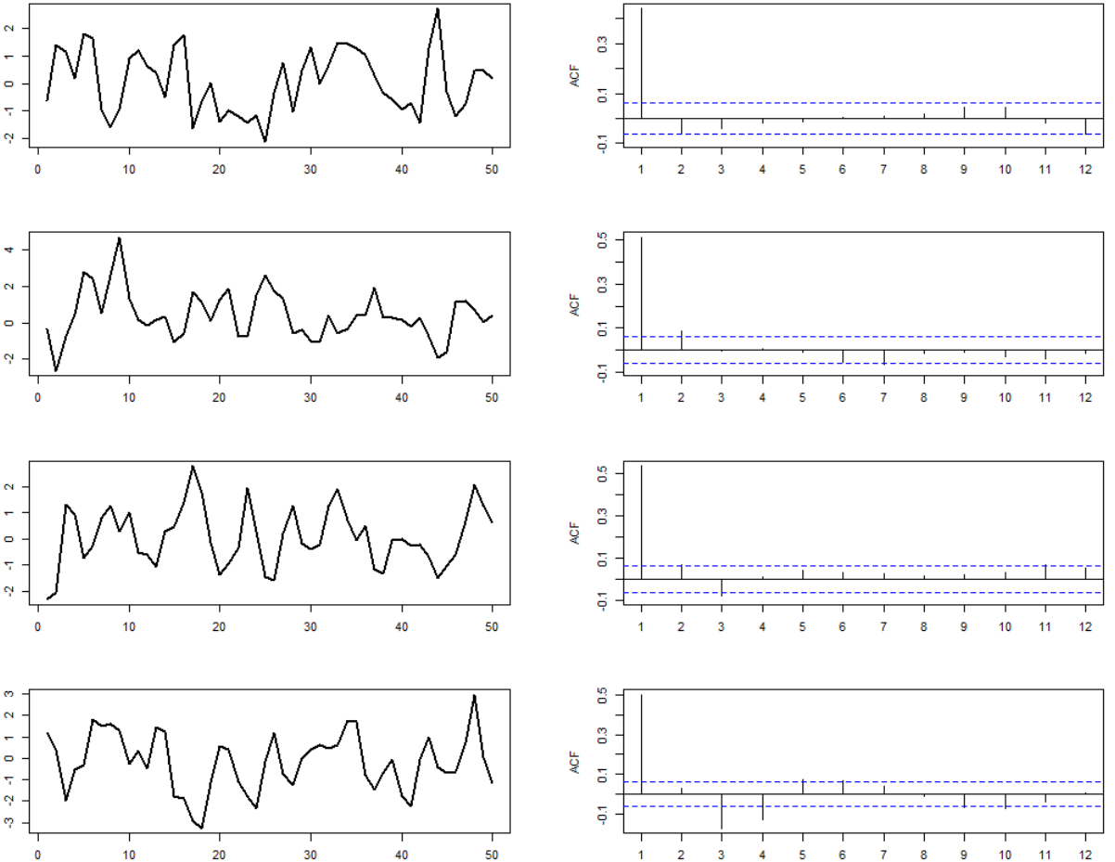
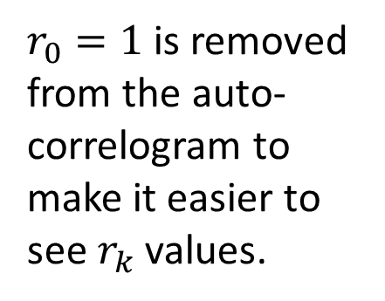
Example
Can you guess the type of the given time series based on their auto-correlogram?
$r_{0}=1$ is removed from the auto-correlogram to make it easier to see $r_{k}$ values.
Notes:
1. Is it a white noise? Nope, this is a MA(1). See that the ACF is plotted for k stating at 1 not zero, so with a big spike at $r_{1}$, this is a MA(1).
2. A MA(2) time series, since we have two big spikes at the beginning and the rest of $r_{k}$ values fall within the interval
3. A MA(3)
4. A MA(4)

Slide 12




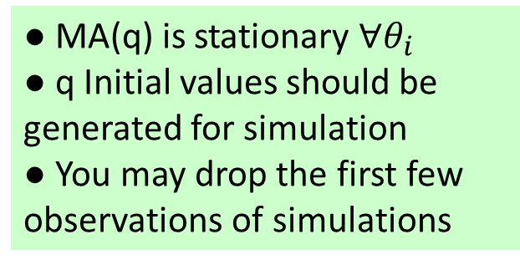




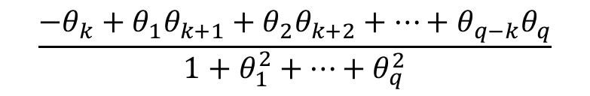






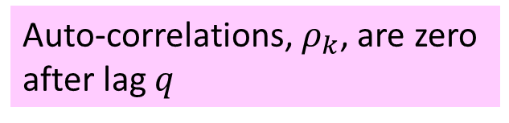

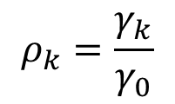


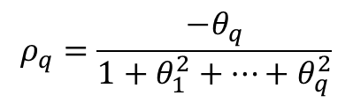
Moving Average of Order q
● MA(q) is stationary $∀θ_{i}$
● q Initial values should be generated for simulation
● You may drop the first few observations of simulations
The following time series is a MA(q)
$$X_{t}=ε_{t}{−θ}_{1}ε_{t−1}{−…−θ}_{q}ε_{t−q}$$
$$ε_{t} \sim ^{i.i.d} N\left(0, σ\right)$$
Auto-correlations, $ρ_{k}$, are zero after lag $q$
$$μ_{t}=$$
$$0$$
$$γ_{0}=$$
$$\left(1+θ_{1}^{2}+…+θ_{q}^{2}\right) σ^{2}$$
$$γ_{k}=$$
$$\left({−θ}_{k}+θ_{1}θ_{k+1}+θ_{2}θ_{k+2}+…+θ_{q−k}θ_{q}\right) σ^{2}$$
$$k=1,…,q$$
$$0$$
$$ρ_{k}$$
$$γ_{k}=$$
$$k=q+1,…$$
$$θ_{1}=0.8,θ_{2}=0.5,θ_{3}=0.5$$
1
$$\frac{{−θ}_{k}+θ_{1}θ_{k+1}+θ_{2}θ_{k+2}+…+θ_{q−k}θ_{q}}{1+θ_{1}^{2}+…+θ_{q}^{2}}$$
$$k=1,…,q$$
$$ρ_{k}=\frac{γ_{k}}{γ_{0}}$$
$$=\left\{\begin{aligned} \\ \\ \end{aligned}\right.$$
$$0$$
$$k=q+1,…$$
$$k$$
0
1
2
3
4
5
6
$$ρ_{q}=\frac{{−θ}_{q}}{1+θ_{1}^{2}+…+θ_{q}^{2}}$$
-1
Notes:
Here ewe generalize what we discussed so far to a moving average of order q, where each value of time series is composed of a weighted average of q noises from the past plus a new noise at the current time step

Slide 13
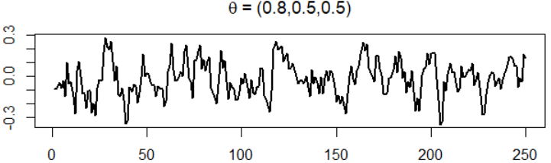



Alternative ACF Plots
Alternative auto-correlograms using ggplot2 package func (bot right), customized func (bot left)
Notes:
There are some packages that help you generate nicer ACF plots, for example this ACF plot is generated using ggplot2, and this one is generated using a customized function. See the R sessions to learn how to generate these variations of autocorrelogram.
And do practice these topics with the provided practice problems

Slide 14

Practice Problems
1. Load “sims.csv” data into your session and answer the following questions for simulated time series $x_{12t}$.
a. Graph a time plot and auto-correlogram. Estimate the order of this moving average time series.
c. Given your estimate order, write down the ACF parametrically.
d. Use the Moment’s Method to estimate the MA parameters.
e. Simulate a time series with the estimated order and parameters and subtract the simulated values from the actual values of the time series. Call this remainder, residuals.
f. Graph the time plot and ACF of the residuals and comment.
2. Repeat the same steps for $x_{14t}$in “sims.csv” dataset.

Slide 15



Practice Problems
3. Generate ACF plot of $x_{11t}$ from sims.csv dataset and estimate the order of this MA time series.
4. Generate ACF plot of $x_{13t}$ from sims.csv dataset and estimate the order of this MA time series.
5. Construct the ACF of the time series $X_{t}=ε_{t}+0.3ε_{t−1}−0.8ε_{t−2}$ where $ε_{t} \sim ^{i.i.d} N\left(0, 1\right)$. Graph the auto-correlogram by hand.
6. Let X and Y be two random variables with respective means μx=75, μy=50, and variances σ²x=16, σ²y=9. Compute the following under two conditions, when X and Y are independent and when their covariance is σxy=4.
a) If L = -Y+2X, then compute E(L) and Var(L)
b) If U = X-2Y, then compute E(U) and Var(U)

